Slide 1
Module 6: Largescale ML - Frequent Itemset
By Prof. Dr. Shanmugam Nandagopalan Ph. D
shanmugamnandagopalan@mfu.ac.th

Slide 2
Agenda
Introduction
Frequent Itemset Mining
A-Priori Algorithm
Algorithm explained
Counting Frequent Items in a Stream
Examples
Park-Chen-Yu Algorithm
Market-Basket Model
What is Market-Basket Problem with Examples
Examples
FP Growth in PySpark

Slide 3
Introduction
Frequent Itemset Mining (FIM) refers to a data mining method which helps in discovering the itemsets that appear frequently in a dataset.
Example
Customers who buy items frequently together in a departmental store.
Students who select two or more courses frequently together.
Bread and Jam
Xiaomi Pad 7 with keyboard and focus pen.
Toothpaste and toothbrush
Applications
Market Basket data analysis, cross-marketing, catalog design, sale campaign analysis, Web log (click stream) analysis, and DNA sequence analysis

Slide 4
Association Rule- Overview
Discovering interesting relationships which are present in large datasets.
The objective is to find uncovered relationships using some strong rules.
The rules are termed as association rules for frequent itemsets.

Slide 5
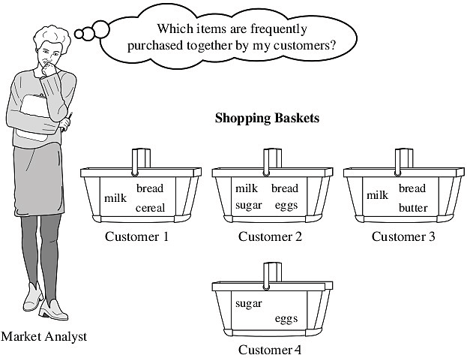
Market-Basket Problem

Slide 6
Market - Basket Analysis
To learn more about the buying patterns of the customers
Helps: plan marketing, advertising strategies, design of new catalogs, etc.
Universe as the set of items available at the store. Each item has a Boolean variable (present/absence)
This boolean vector can be analyzed for buying patterns – association rules:
Computer → antivirus_software [support = 1%, confidence = 50%]
min. support threshold & min. confidence threshold – set by domain experts

Slide 7
Basic Concepts: Frequent Patterns and Association Rules
Transaction-id | Items bought
10 | A, B, D
20 | A, C, D
30 | A, D, E
40 | B, E, F
50 | B, C, D, E, F
Itemset I = {I1, …, Ik}
Find all the rules A→ B with minimum support and confidence
support, s, probability that a transaction contains P(A∪B)
confidence, c, conditional probability that a transaction having A also contains B. Or, P(B|A)
Customer
buys both
Customer
buys jam
Let sup_{min} = 50%, conf_{min} = 50%
Freq. Pattern: {A:3, B:3, D:4, E:3, AD:3}
Association rules:
A → D (60%, 100%),
s = N_{A,D}/N*100, c = N_{A,D} /N_{A}*100
D → A (60%, 75%)
Customer
buys bread

Slide 8
Association Rule Mining – Example 2
Market-Basket transactions
Example of Association Rules
{Diaper} → {Beer}, {Milk, Bread} → {Eggs,Coke}, {Beer, Bread} → {Milk},
Implication means co-occurrence, not causality!

Slide 9
Definition: Frequent Itemset
Itemset
A collection of one or more items
Example: {Milk, Bread, Diaper}
k-itemset
An itemset that contains k items
Support count (σ)
Frequency of occurrence of an itemset
E.g. σ({Milk, Bread,Diaper}) = 2
Support
Fraction of transactions that contain an itemset
E.g. s({Milk, Bread, Diaper}) = 2/5
Frequent Itemset
An itemset whose support is greater than or equal to a minsup threshold

Slide 10
Association Rule : Example
Association Rule
An implication expression of the form X → Y, where X and Y are itemsets
Example: {Milk, Diaper} → {Beer}
Rule Evaluation Metrics
Support (s)
Fraction of transactions that contain both X and Y
Confidence (c)
Measures how often items in Y appear in transactions that contain X
Example:

Slide 11
Association Rule Mining Task
Given a set of transactions T, the goal of association rule mining is to find all rules having
support ≥ minsup threshold
confidence ≥ minconf threshold
Brute-force approach:
List all possible association rules
Compute the support and confidence for each rule
Prune rules that fail the minsup and minconf thresholds
⇒ Computationally prohibitive!

Slide 12
Mining Association Rules
Example of Rules:
{Milk,Diaper} → {Beer} (s=0.4, c=0.67) {Milk,Beer} → {Diaper} (s=0.4, c=1.0)
{Diaper,Beer} → {Milk} (s=0.4, c=0.67)
{Beer} → {Milk,Diaper} (s=0.4, c=0.67) {Diaper} → {Milk,Beer} (s=0.4, c=0.5)
{Milk} → {Diaper,Beer} (s=0.4, c=0.5)
Observations:
All the above rules are binary partitions of the same itemset: {Milk, Diaper, Beer}
Rules originating from the same itemset have identical support but can have different confidence
Thus, we may decouple the support and confidence requirements

Slide 13
Mining Association Rules
Two-step approach:
Frequent Itemset Generation
Generate all itemsets whose support ≥ minsup
Rule Generation
Generate high confidence rules from each frequent itemset, where each rule is a binary partitioning of a frequent itemset
Frequent itemset generation is still computationally expensive

Slide 14
Frequent Itemset Generation
Given d items, there are 2^{d} possible candidate itemsets

Slide 15
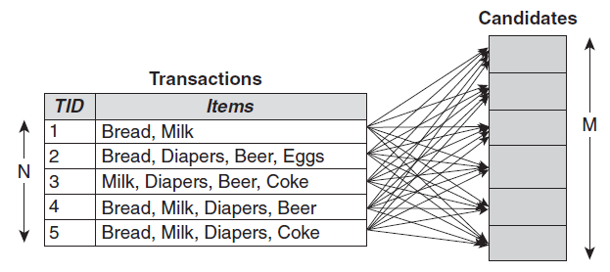
Frequent Itemset Generation
Brute-force approach:
Each itemset in the lattice is a candidate frequent itemset
Count the support of each candidate by scanning the database
Match each transaction against every candidate
Complexity ~ O(NMw) => Expensive since M = 2d !!!

Slide 16
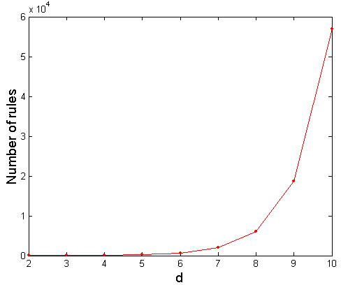
Computational Complexity
Given d unique items:
Total number of itemsets = 2d
Total number of possible association rules:
If d=6, R = 602 rules

Slide 17
Frequent Itemset Generation Strategies
Reduce the number of candidates (M)
Complete search: M=2d
Use pruning techniques to reduce M
Reduce the number of transactions (N)
Reduce size of N as the size of itemset increases
Used by DHP and vertical-based mining algorithms
Reduce the number of comparisons (NM)
Use efficient data structures to store the candidates or transactions
No need to match every candidate against every transaction

Slide 18
Apriori Algorithm

Slide 19
Methods for Mining Frequent Patterns
The Apriori Algorithm: Finding frequent Itemsets using candidate generation
Uses the prior knowledge of frequent itemset
Apriori property: “All non-empty subsets of a frequent itemset must also be frequent”
k-itemsets are used to explore (k+1) itemset
L1 – one-itemset, L2 – 2-itemset, Lk – k-itemset , etc
Step-1: Join step: To find Lk, a set of candidate k-itemset is generated by joining Lk-1 with itself, denote as Ck.
Step-2: Prune step: Ck is superset of Lk, i.e. its members may or may not be frequent, but all of the frequent k-itemsets are included in Ck. Do subset testing.

Slide 20
Illustrating Apriori Principle
Found to be Infrequent
Pruned supersets

Slide 21
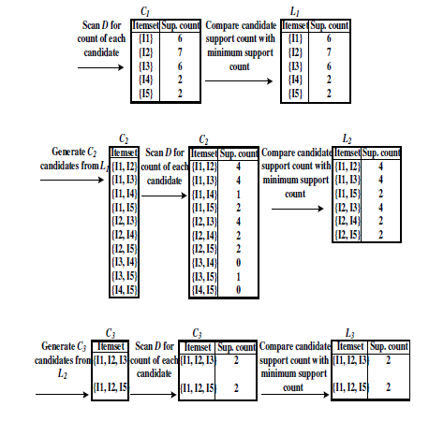
Example
TID | Item ids
T100 | I1, I2, I5
T200 | I2, I4
T300 | I2, I3
T400 | I1, I2, I4
T500 | I1, I3
T600 | I2, I3
T700 | I1, I3
T800 | I1, I2, I3, I5
T900 | I1, I2, I3

Slide 22
The Apriori Algorithm
// C_{k}: Candidate itemset of size k
// L_{k} : frequent itemset of size k
L₁ = {frequent items};
for (k = 1; L_{k} !=∅; k++) do
C_{k+1} = candidates generated from L_{k};
for each transaction t in database do
increment the count of all candidates in C_{k+1} that are contained in t
endfor
L_{k+1} = candidates in C_{k+1} with min_support
endfor
return ∪_{k} L_{k};

Slide 23
Reducing Number of Comparisons
Candidate counting:
Scan the database of transactions to determine the support of each candidate itemset
To reduce the number of comparisons, store the candidates in a hash structure
Instead of matching each transaction against every candidate, match it against candidates contained in the hashed buckets

Slide 24
Computing Interestingness Measure
Given a rule X → Y, information needed to compute rule interestingness can be obtained from a contingency table
Contingency table for X → Y
 | Y | Y
X | f₁₁ | f₁₀ | f₁₊
X | f₀₁ | f₀₀ | f_{o+}
 | f₊₁ | f₊₀ | |T|
f₁₁: support of X and Y f₁₀: support of X and Y f₀₁: support of X and Y f₀₀: support of X and Y
Used to define various measures
support, confidence, lift, Gini, J-measure, etc.

Slide 25
Drawback of Confidence
 | Coffee | Coffee
Tea | 15 | 5 | 20
Tea | 75 | 5 | 80
 | 90 | 10 | 100
 |  | Disease
 |  | yes | no | total
Smoking | yes | 13 | 37 | 50
 | no | 6 | 144 | 150
 | total | 19 | 181 | 200
Association Rule: Tea → Coffee Smoking → Disease
Confidence= P(Coffee|Tea) = 0.75
but P(Coffee) = 0.9
Although confidence is high, rule is misleading
P(Coffee|Tea) = 0.9375

Slide 26
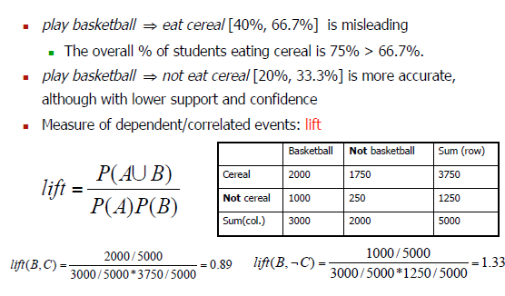
Example 2

Slide 27

Interestingness Measure: Correlations (Lift)
To overcome this, we have
A B [support, confidence, correlation]
Lift is a simple correlation measure
If lift < 1, then A and B are negatively correlated
If lift > 1, then A and B positively correlated
If lift = 1, then A and B are independent
Since lift < 1, it is negatively correlated
Chi-square test:
Gives the same measure as lift

Slide 28
Statistical-based Measures
Measures that take into account statistical dependence

Slide 29
Example: Lift/Interest
 | Coffee | Coffee
Tea | 15 | 5 | 20
Tea | 75 | 5 | 80
 | 90 | 10 | 100
Association Rule: Tea → Coffee
Confidence= P(Coffee|Tea) = 0.75
but P(Coffee) = 0.9
Lift = 0.75/0.9= 0.8333 (< 1, therefore is negatively associated)

Slide 30
Drawback of Lift & Interest
 | Y | Y
X | 10 | 0 | 10
X | 0 | 90 | 90
 | 10 | 90 | 100
 | Y | Y
X | 90 | 0 | 90
X | 0 | 10 | 10
 | 90 | 10 | 100
Statistical independence:
If P(X,Y)=P(X)P(Y) => Lift = 1

Slide 31
Counting Frequent Items in a Stream

Slide 32
Introduction
What is a stream item?
These are only available when they arrive.
The arrival rate is so great that we cannot store the entire stream in a way that allows easy querying.
The itemsets that are frequent in today’s stream may not be frequent tomorrow.
There is no end to a stream, unlike a file.

Slide 33
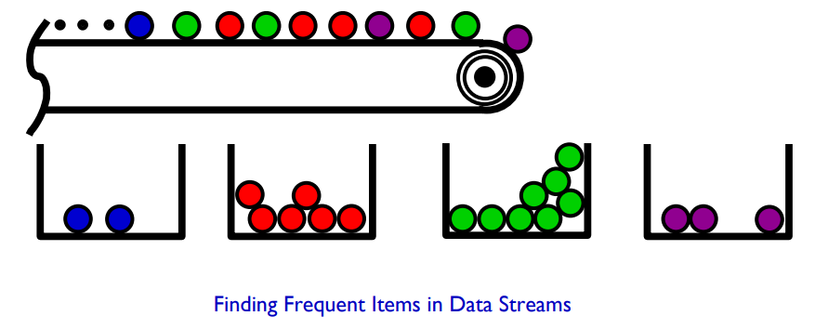
The Frequent Items Problem
The Frequent Items Problem (aka Heavy Hitters): given stream of N items, find those that occur most frequently
E.g. Find all items occurring more than 1% of the time
Formally “hard” in small space, so allow approximation
Find all items with count ≥ φN, none with count < (φ−ε)N – Error 0 < ε < 1, e.g. ε = 1/1000 – Related problem: estimate each frequency with error ±εN

Slide 34
Why Frequent Items?
A natural question on streaming data – Track bandwidth hogs, popular destinations etc.
The subject of much streaming research – Scores of papers on the subject
A core streaming problem – Many streaming problems connected to frequent items (itemset mining, entropy estimation, compressed sensing)
Many practical applications – Search log mining, network data analysis, DBMS optimization

Slide 35
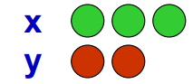
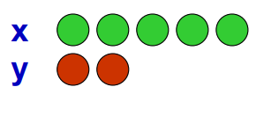
Data Stream Models
We model data streams as sequences of simple tuples
Complexity arises from massive length of streams
Arrivals only streams: – Example: (x, 3), (y, 2), (x, 2) encodes the arrival of 3 copies of item x, 2 copies of y, then 2 copies of x. – Could represent eg. packets on a network; power usage
Arrivals and departures: – Example: (x, 3), (y,2), (x, -2) encodes final state of (x, 1), (y, 2). – Can represent fluctuating quantities, measure differences between two distributions, or represent general signals

Slide 36
Park-Chen-Yu (PCY) Algorithm

Slide 37
Introduction
The Apriori Algorithm finds frequent itemsets by making several passes over a dataset.
We can see that the memory requirements will grow quite quickly as the number of frequent items increases, since the number of possible candidate pairs skyrockets.
Park, Chen, and Yu is a Hash Based Algorithm. The algorithm uses hashing during the first pass to reduce the number of candidate pairs that are considered in the second pass.
What is PCY algorithm?
Answer: The PCY algorithm is designed to find frequent item sets in Big Data by efficiently pruning infrequent items to improve computational efficiency.

Slide 38
A Key Intuition
The PCY algorithm utilizes a main memory representation with a two-pass approach involving item counting, hash table creation, and the use of bitmaps.
This optimization helps in reducing computational complexity and improving efficiency.
If items that started with the letter ‘a’ < min. support then none of the items with start letter ‘a’ are frequent.
It uses modified Hash technique.
Each bucket = single integer that represents the number of times something has hashed to that bucket.

Slide 39
Example
Let s = 3 be the support cutoff for being considered ‘frequent’.
Consider the dataset as: Apples, Avocados, Bacon, Blueberries, Carrots Almonds, Avocados, Bacon, Bananas, Durian Almonds, Bacon Avocado, Bananas Almonds
Step 1 (1 frequent itemset): The count = 1, after processing the first basket.
Step 2 (2 frequent itemset): The possible pairs are: {apples, avocados}, {apples, bacon} {apples, blueberries}, {apples, carrots} {avocados, bacon}, {avocados, blueberries}, ……………

Slide 40
Contd.
hash function - take the first letter in each item and put them together into a string.
Example
{apples, avocados} → ‘aa’ {apples, bacon} → ‘ab’ {apples, blueberries} → ‘ab’
Step 3: keep track of how many times each hash has appeared.
The hash ‘aa’ = 1, and hash ‘ab’ = 4.
The bucket count represents the maximum possible number of times that any pair that hashes to that bucket can appear in the dataset.

Slide 41
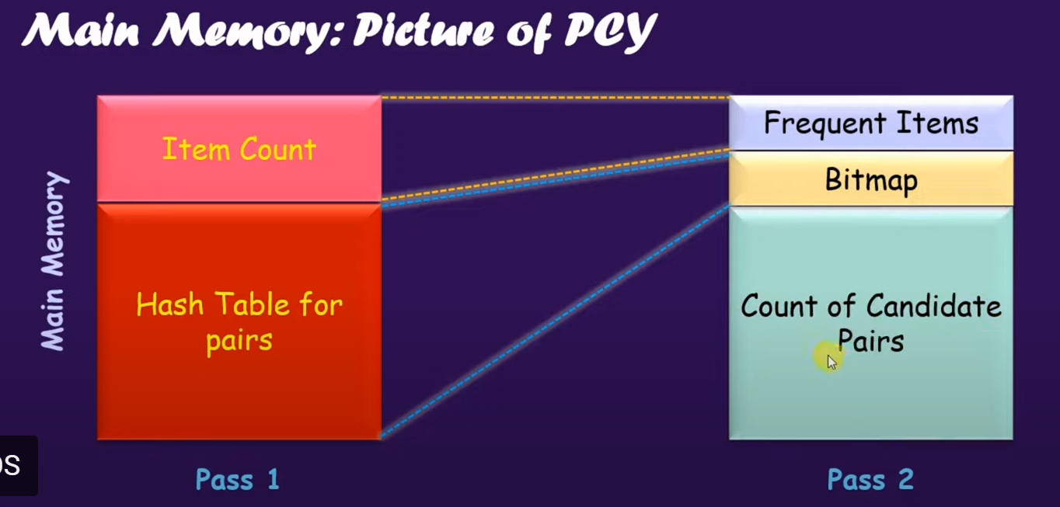
Concept

Slide 42
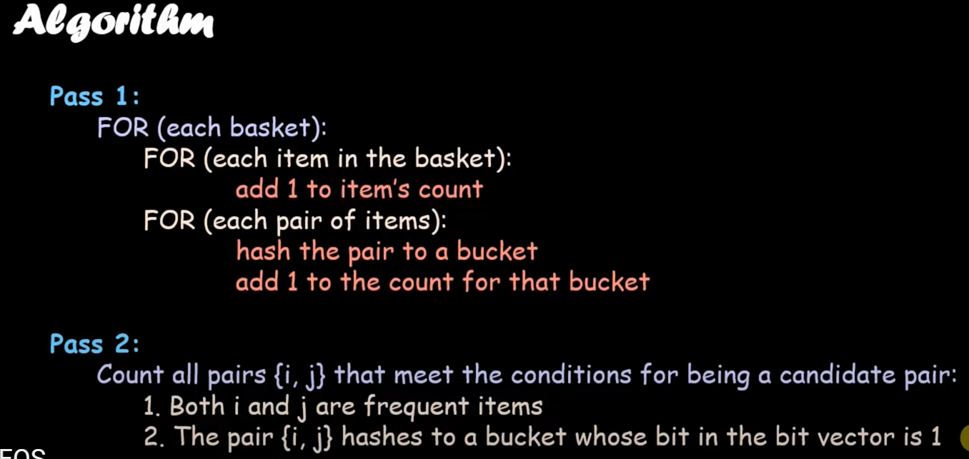
PCY Algorithm

Slide 43
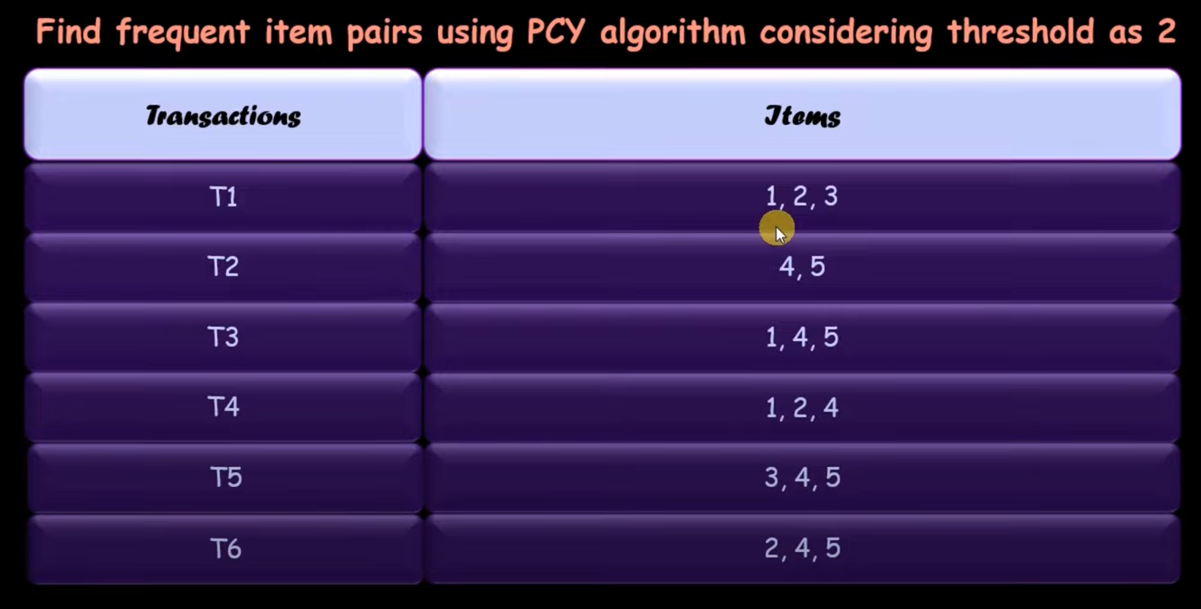
Example

Slide 44
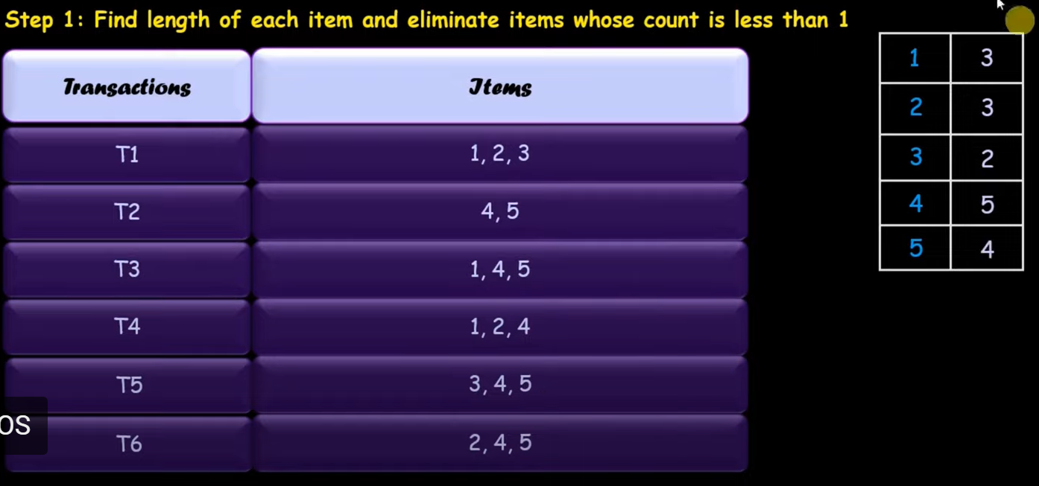
Step 1
2

Slide 45
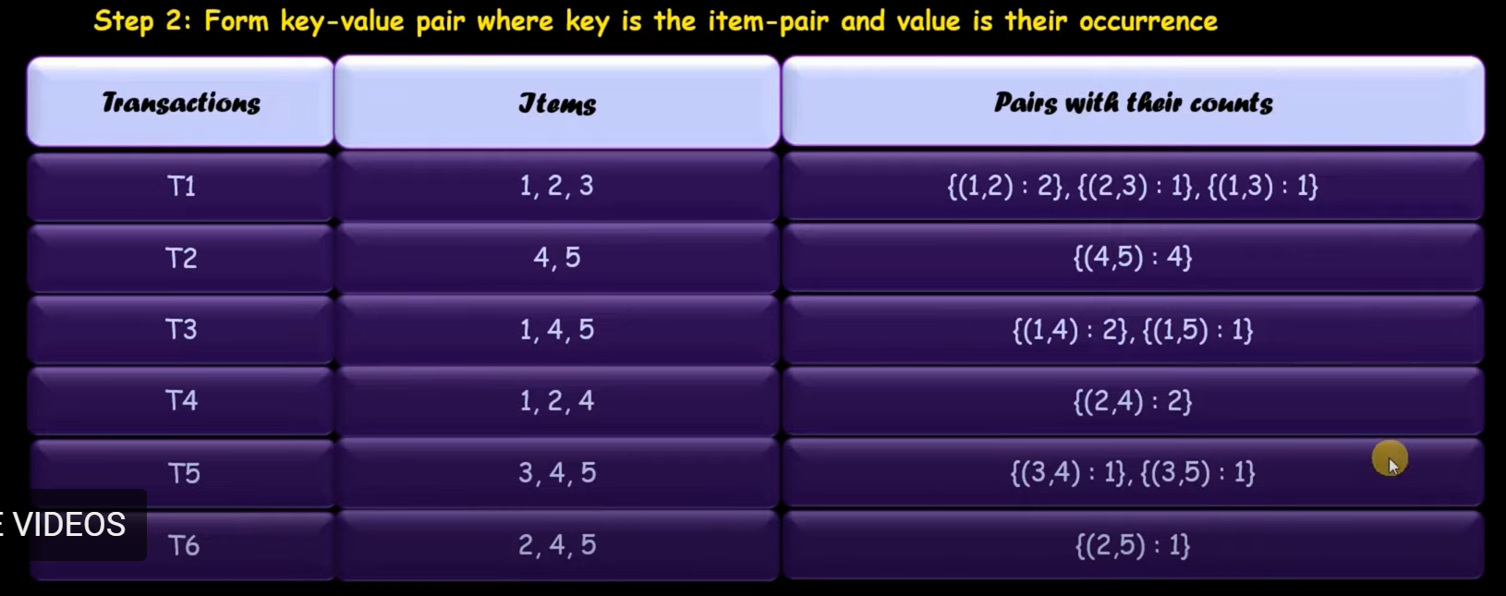
Step 2

Slide 46
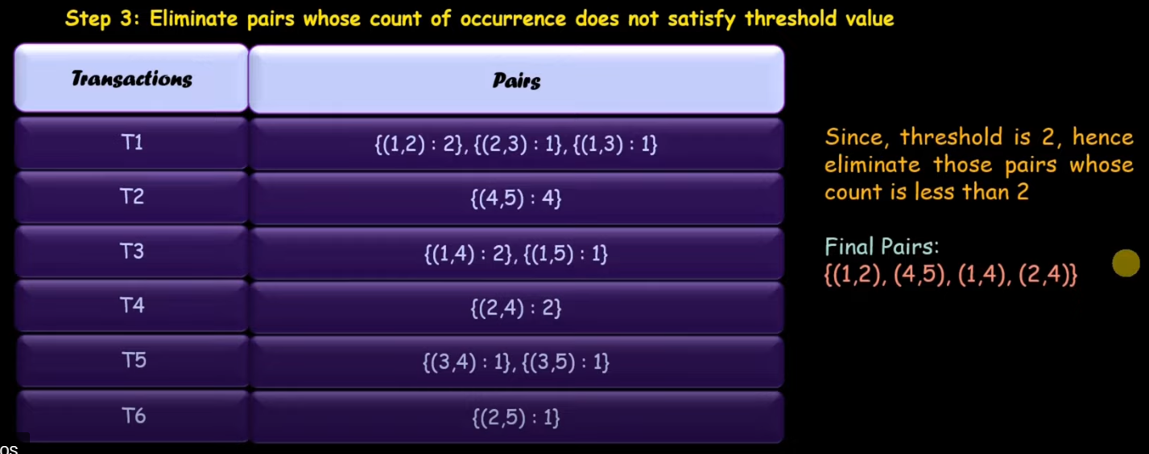
Step 3

Slide 47
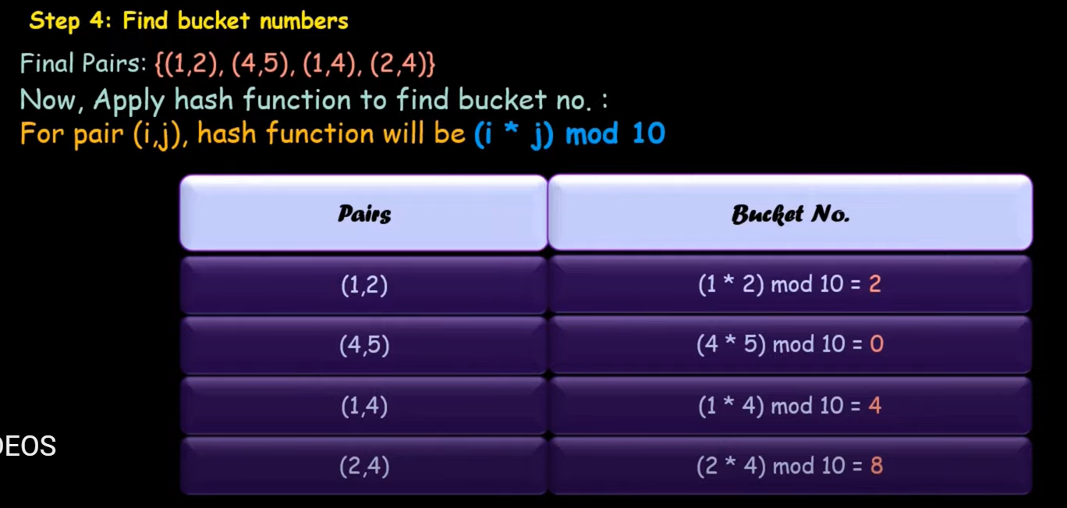
Step 4

Slide 48
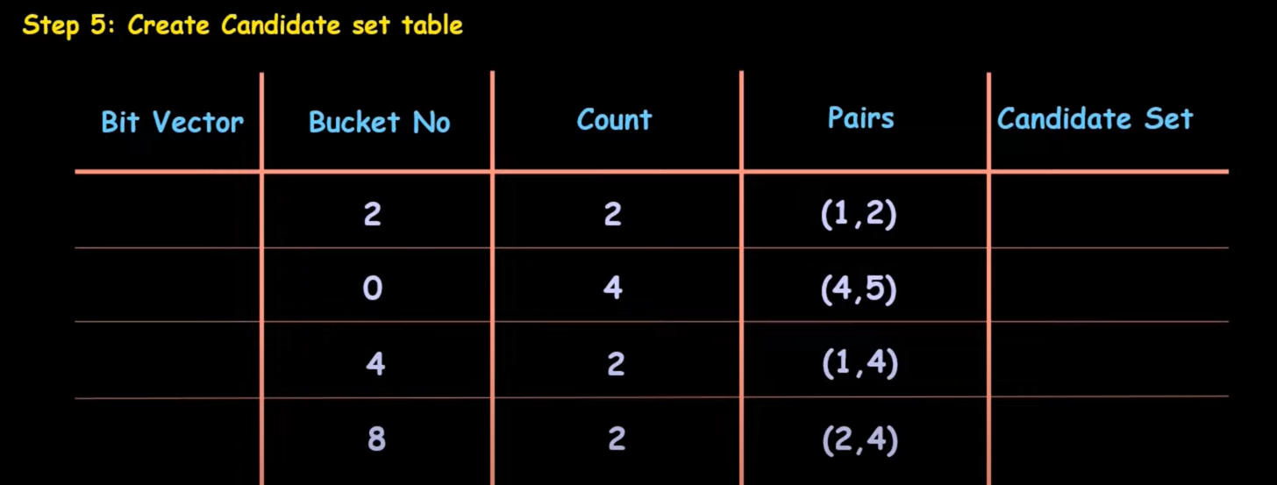
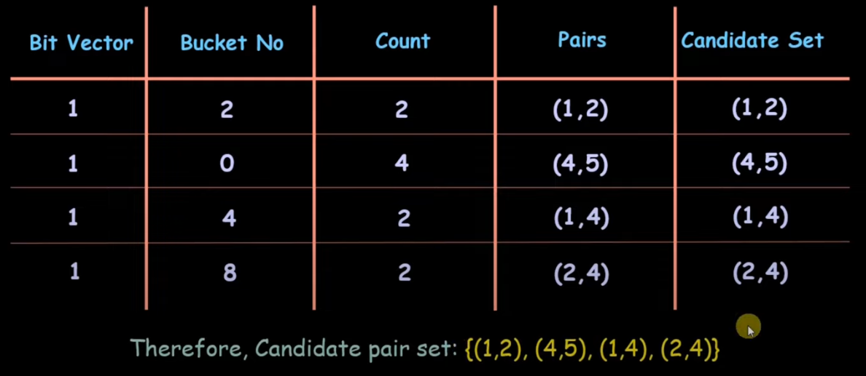
Step 5

Slide 49
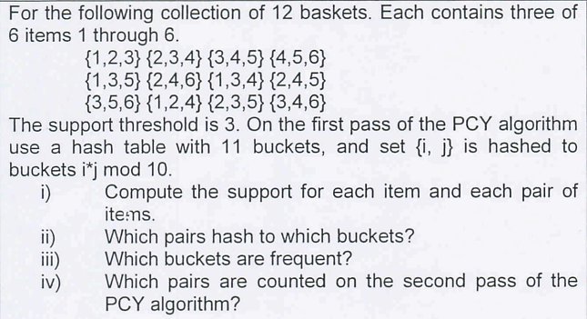
Exercise

Slide 50
Exercise
For the following collection of 12 baskets. Each contains three of 6 items 1 through 6.
{1,2,3} {2,3,47 {3,4,5} {4,5,6}
{1,3,5} {2,4,6} {1,3,4}
{2,4,5} {3,5,6} {1,2,4}
{2,3,5} {3,4,6}
The support threshold is 3. On the first pass of the PCY algorithm use a hash table with 11 buckets, and set {i, i} is hashed to buckets i*j mod 10.
Compute the support for each item and each pair of items.
Which pairs hash to which buckets?
Which buckets are frequent?
Which pairs are counted on the second pass of the

Slide 51
Thank You

